Slide 1
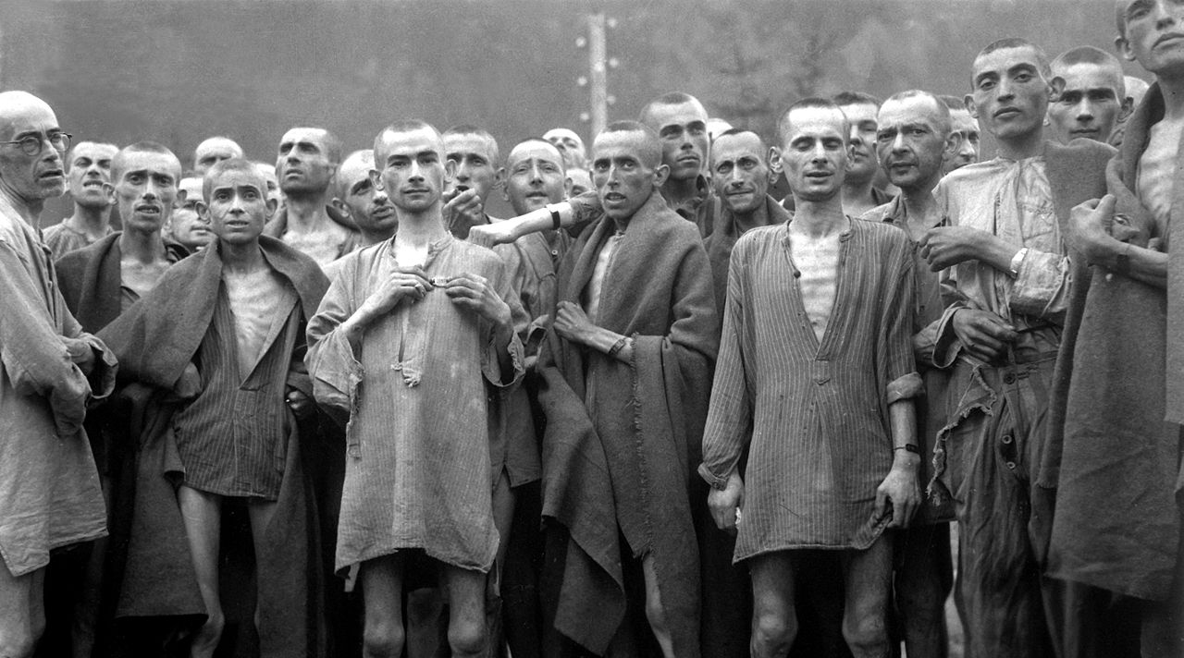
A Look Into Hitler’s Concentration Camps
Death Camps of the Holocaust
Eliz Markowitz

Slide 2
Purpose & Creation
Purpose
Forced detainment of individuals under ruthless conditions without consideration for human rights.
Implementation
Dachau, the first concentration camp, was built in 1933
Located in Germany, Holland, Austria, Poland, Ukraine, Slovakia, Estonia, and the Czech Republic

Slide 3
Rationale for Camps
Hitler’s “Final Solution”
Prisoner identification Scheme
Create a superior Aryan race
Eradicate the Jewish people from Europe through imprisonment and mass genocide
Eliminate all other “enemies of the state”
Communists, Socialists, and Social Democrats
Roma and Jehovah's Witnesses
Homosexuals and other socially deviant individuals

Slide 4
Types of Camps
Labor
Prisoners forced to do strenuous physical labor in atrocious working conditions under the guidance of abusive soldiers.
Transit
Inmates collected and transferred to other camps
Hostage
Prisoners held and killed as retaliation
Prisoner of War
Individuals held and usually transferred to labor camps
Rehabilitation
Inmates re-educated in accordance with the Nazi’s social and political views
Extermination
Solely existed for the purpose of murder. Upon arrival, all individuals would be exterminated.

Slide 5
Transportation & Arrival
Transportation
Prisoners loaded onto cattle trucks
Packed in tightly with no food, water, or hygiene facilities
Processing
Families separated and personal belongings confiscated
Prisoners forced to undress, shower, and have head shaved
Tattooed with a unique prisoner number

Slide 6
Prisoner Processing
Guards confiscate personal belongings from newly arrived prisoners at the Jasenovac concentration camp in Yugoslavia.
© 2011 United States Holocaust Memorial Museum

Slide 7
Living Conditions
Barracks
Brick or wooden beds with moldy straw
No heating or insulation
Vermin infested
Personal Care
No suitable sanitation
Limited water supply
High rate of contagions that led to epidemics and disease

Slide 8
Rations
Starvation Rations
Morning Meal
Imitation coffee or tea
Afternoon Meal
One liter of watery soup
Evening Meal
300 mg black bread
Small piece of sausage, cheese, or marmalade
Muzulman State
Deterioration of organs that led to physical exhaustion and death

Slide 9
Labor
Minimum 11-hour day of strenuous physical labor
Factory
Construction
Ditch & grave digging
Mining
Laying roads
Weapon and chemical production
People unable to work were murdered

Slide 10
The Appel
Appel—Daily Lineup
Roll call that occurred every morning and evening
Prisoners exposed to the elements, such as snow, ice, and rain, with only thin uniforms for protection
Prisoners forced to stand completely still for hours at a time
Movement led to beating or death

Slide 11
Medical Experimentation
Focused on enhancing the survival of Axis forces
Freezing Experiments
Attempt to find treatment for hypothermia
Seawater
Attempt to turn seawater into drinkable water
High-Altitude Experiments
Individuals placed in a low pressure chamber to find effective range of parachutes

Slide 12
Medical Experimentation
Racial & Ideological
Eye Color
Attempt to alter and fabricate eye color
Twin
Aimed at understanding twin genetics in an attempt to find a way to effectively multiply the Aryan race
Sterilization
Attempts to create efficient ways of sterilizing men and women to halt unsavory reproduction

Slide 13
Medical Experimentation
Pharmaceutical testing and ‘injury’ treatment
Immunization
Experimental treatment for malaria, typhus, typhoid, hepatitis, yellow fever, and tuberculosis
Bone, muscle, and joint
Study the effect of limb transplant post- amputation
Removal of sections to study regeneration
Poison
Testing of phenol and cyanide to study reactions

Slide 14
Death
Physical exhaustion, malnutrition, and disease
Shooting
Prisoners would be forced to dig their own graves and were then executed
Gas chambers
Carbon Monoxide and Hydrogen Cyanide poisoning
Lethal injection
The preferred method of execution for the 1.1 million children murdered in camps
Medical Experimentation
If individuals survived the experiment, they would be murdered for the purpose of conducting an autopsy

Slide 15
The Fall of the Camps
In July 1944, Soviet troops arrived at the Majdanek camp in Poland.
Germans tried to hide evidence of genocide
Demolished camp
Murdered remaining prisoners and burned down crematorium
Failed to remove evidence of mass murder

Slide 16
Liberation
Soviets liberated Auschwitz, perhaps the most notorious death camp, in January 1945.
U.S. and British forces liberated Buchenwald and other German camps in April 1945.
Approximately 80,000 prisoners were liberated prior to the conclusion of the war.

Slide 17
Post-Liberation
Only a small percentage of prisoners survived.
Survivors looked like skeletons due to the physical demands, malnutrition, and maltreatment.
Disease remained a danger
Many survivors died post-liberation due to the effects of internment.

Slide 18
Resources
United States Holocaust Memorial Museum
Jewish Virtual Library
NOVA Online | Holocaust on Trial | The Experiments
The Holocaust – Labor and Concentration Camps – Yad Vashem
Nazi Concentration Camp Records: Story, Pictures, and Information

